Slide 1
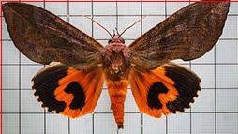
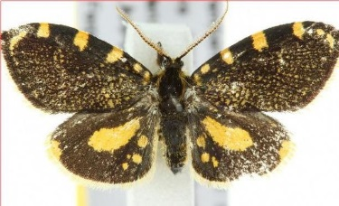
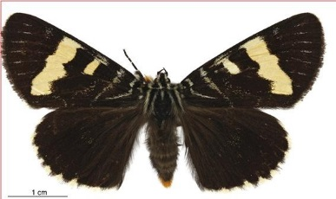
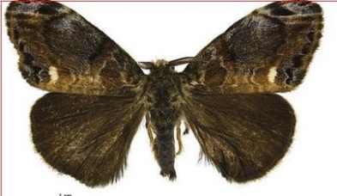

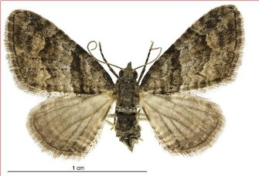
STREAM 1
LIKELIHOOD OF INSECTS BEING PHOTOGRAPHED
What factors affect the likelihood of an insect being photographed by a citizen scientist ?
Have most (Exotic) species been already observed ?
How have exotic species spread across different regions of NZ ?
Which time of the year most species have been observed in ?
STREAM 2
RECOMMENDING VISUALLY SIMILAR IMAGES
INPUT IMAGE : MOBILE APP USER
Not to be copied
MACHINE / DEEP
LEARNING
OUTPUT IMAGES

Slide 2
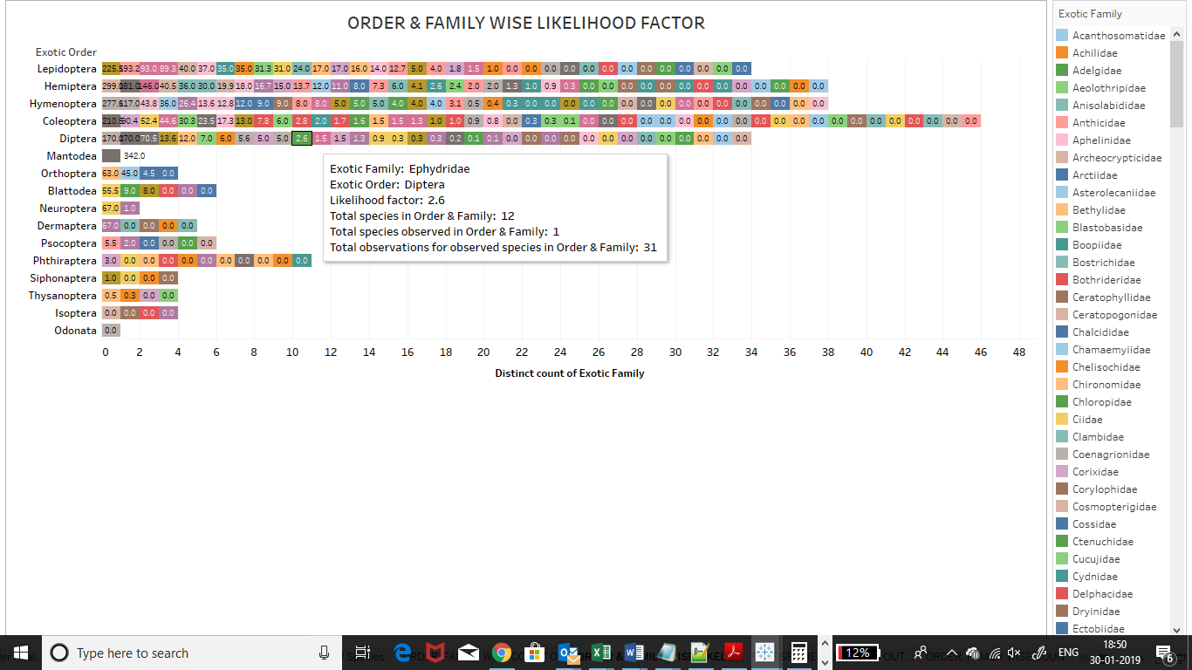
LIKELIHOOD OF AN INSECT TO BE CLICKED BELONGING TO AN ORDER AND FAMILY ?
Not to be copied
Likelihood Factor = 1/12 x 31
= 2.6
Number of Species Observed Likelihood of being Photographed = ----------------------------------------- X Number of Observations of the Family Number of Species in the Family

Slide 3
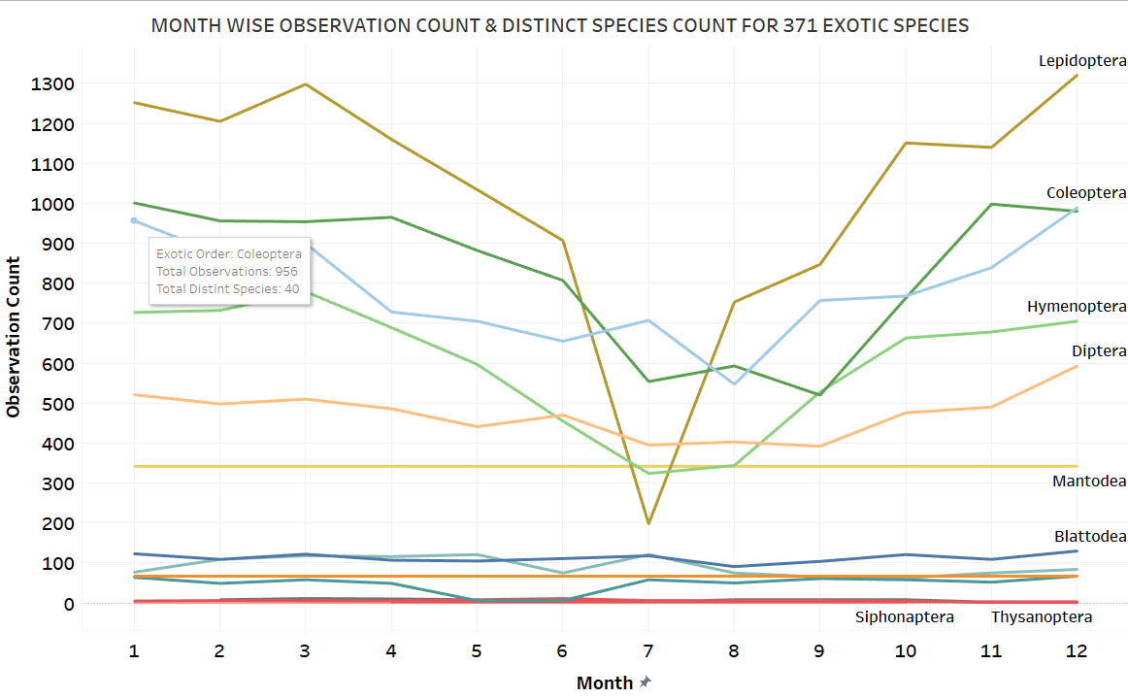
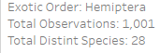
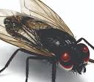
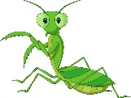
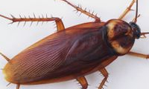
WHEN ARE PEOPLE MORE ACTIVE IN OBSERVING INSECTS IN NZ ?
Notice that the Number of Species Observed is More in Coleoptera than Hemiptera
Not to be copied

Slide 4
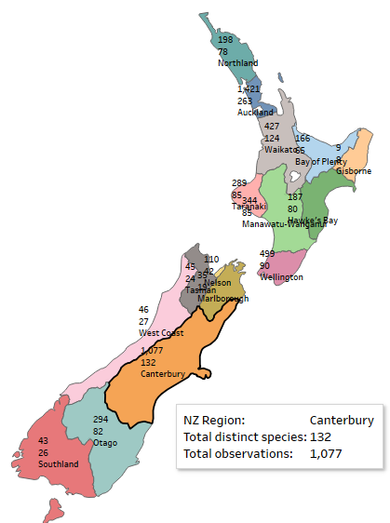
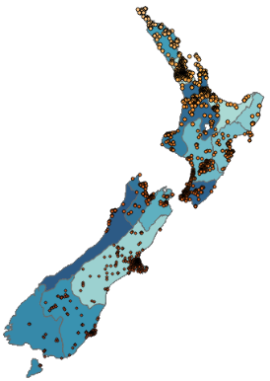
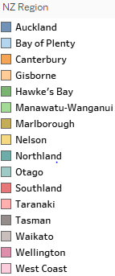
WHERE ARE THE INSECTS BEING PHOTOGRAPHED?
Not to be copied

Slide 5
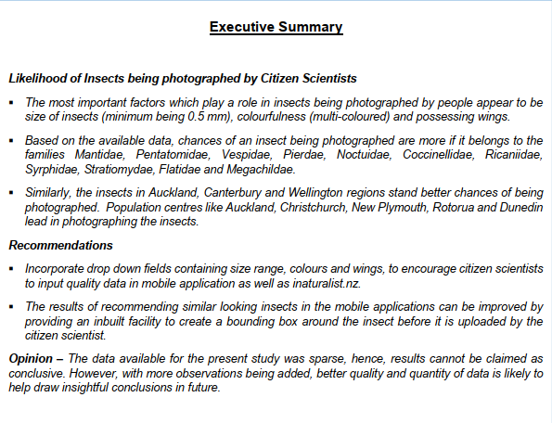
Not to be copied

